Slide 1



Module 1
Excel and Copilot for Data Productivity

Slide 2

Disclaimer
The content is curated from online/offline resources and used for educational purpose only

Slide 3

Learning Outcome
You will learn in this Chapter:
Explain data, information, insight, and decisions with simple examples.
Import and structure raw datasets in Excel for effective data handling.
Perform sorting and filtering operations to organize and extract relevant information.
To introduce AI tools that enhance productivity and automate Excel analysis.
To provide hands-on experience with real-world datasets and business scenarios.

Slide 4
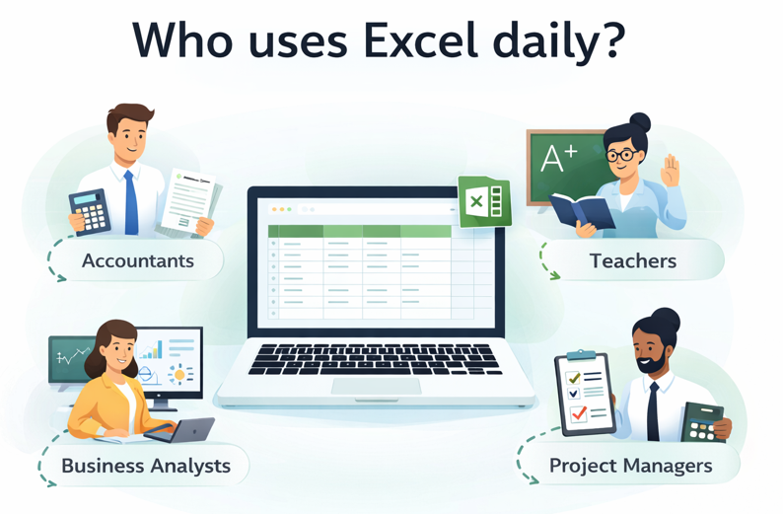

Introduction
Source: https://www.i-scoop.eu/wp-content/uploads/2016/07/The-traditional-data-information-knowledge-wisdom-pyramid-source-Mushon.gif
Notes:
Excel is one of the most widely used tools across industries. It’s not just for accountants or data analysts - professionals in marketing, finance, HR, operations, and even small business owners rely on Excel daily. From managing budgets and analyzing trends to tracking performance and creating reports, Excel empowers users to make data-driven decisions. Its versatility makes it a go-to tool for anyone who needs to organize, analyze, and visualize data efficiently.

Slide 5

What is Microsoft Excel?
Microsoft Excel is a powerful spreadsheet program developed by Microsoft
Organize and manage data in rows & columns (grids)
Perform calculations using formulas and functions
Create professional charts, graphs & dashboards
Analyze large datasets (sorting, filtering, pivot tables)
Source: https://media.licdn.com/dms/image/v2/D5622AQG-quF44G4Mrg/feedshare-shrink_2048_1536/B56ZiYg5rKH0A0-/0/1754905419174?e=2147483647&v=beta&t=NpoTt599xj4AqbBcgwKuNNXmbIA56M8-ZACZFtpF8So
Notes:
Microsoft Excel is a powerful spreadsheet application developed by Microsoft. It allows users to organize, analyze, and visualize data using rows and columns. Excel supports features like formulas, functions, charts, pivot tables, and data analysis tools, making it essential for tasks such as budgeting, reporting, forecasting, and decision-making across various industries.

Slide 6
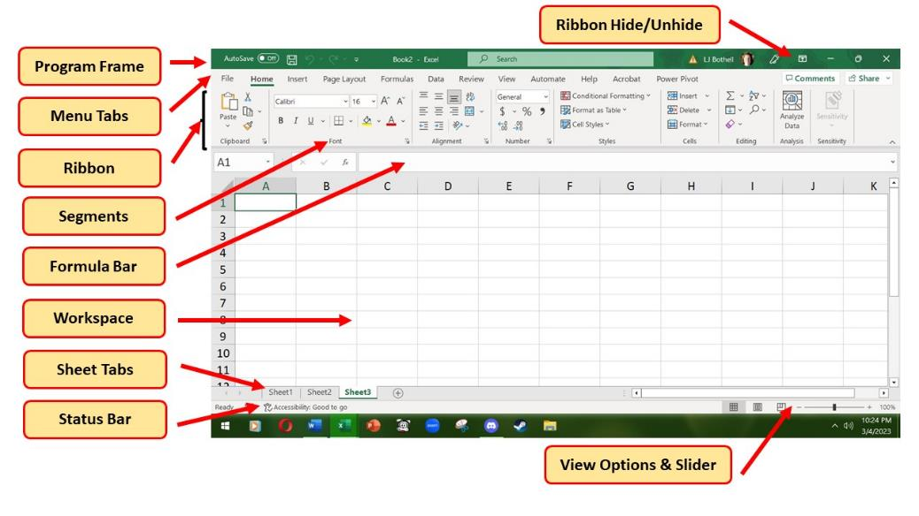
Excel Interface: Key elements of Excel
Source: https://worksheets.clipart-library.com/images2/definition-of-worksheet-in-excel/definition-of-worksheet-in-excel-18.jpeg
Notes:
Explanation of the Excel Interface and its key elements:
Program Frame
The outermost frame of the Excel window.
Displays the application name and window controls (Minimize, Maximize, Close).
Menu Tabs
Located at the top (File, Home, Insert, Page Layout, Formulas, Data, Review, View, etc.).
Each tab contains groups of related commands.
Ribbon
Below the menu tabs.
Displays tools and options grouped under each tab (e.g., Clipboard, Font, Alignment, Number).
Includes buttons for formatting, formulas, charts, and more.
Segments
Sections within the Ribbon (e.g., Font, Alignment, Number).
Each segment contains related commands for quick access.
Formula Bar
Located below the Ribbon.
Shows the contents of the active cell.
Used to enter or edit data and formulas.
Workspace
The main grid area where data is entered.
Organized into rows (numbered) and columns (lettered).
Intersection of row and column is a cell.
Sheet Tabs
Located at the bottom of the workspace.
Allows switching between different sheets in a workbook.
Options to add, rename, or delete sheets.
Status Bar
Located at the bottom of the Excel window.
Displays information like Ready, Edit mode, and quick calculations (Sum, Average).
Includes View Options and Zoom Slider for adjusting the view.
Ribbon Hide/Unhide
Button at the top-right corner.
Allows collapsing or expanding the Ribbon for more workspace.
View Options & Slider
Located at the bottom-right corner.
Includes Normal, Page Layout, and Page Break Preview.
Zoom slider to adjust the zoom level of the worksheet.

Slide 7

Data Entry
Data entry in Excel means entering information into worksheet cells.
A worksheet is made up of rows and columns that form cells.
Each cell is identified by a cell address combining column and row.
Example: The top-left cell is A1.
Excel supports different types of data such as text, numbers, dates, and symbols.
Example: 12/08/2025 is treated as a date, while 12082025 is treated as a number.
Source: https://www.shutterstock.com/image-vector/spreadsheet-concept-business-team-analyze-260nw-2344020923.jpg
Notes:
Data entry is the first and most basic task when working in Microsoft Excel. A worksheet in Excel is made up of rows and columns that intersect to form cells. Every cell has a unique address based on its column label and row number. For example, the cell in column A and row 1 is referred to as A1. Knowing cell addresses is important because formulas and references in Excel depend on them.
Data can be entered into Excel by simply clicking on a cell and typing, or by pasting information copied from another file. For example, a student list can be copied from a text file and pasted into a worksheet.
Excel allows different types of data:
Text is used for names, categories, or labels, such as entering "Mathematics" in the header of a column.
Numbers are used for values like marks, quantities, or expenses. For instance, entering "75" for a test score.
Dates and Time are useful for recording daily schedules, attendance, or event dates. If you type "12/08/2025," Excel will store it as a date and allow you to perform date-based calculations.
Symbols or Special Characters like percentage signs or currency symbols can also be included when required, for example, entering "50%" or "₹500."
It is important to distinguish between data formats because Excel interprets them differently. For example, entering "12082025" will be considered a number, while typing "12/08/2025" will be treated as a date. This distinction matters because calculations and formatting options change depending on the data type.

Slide 8
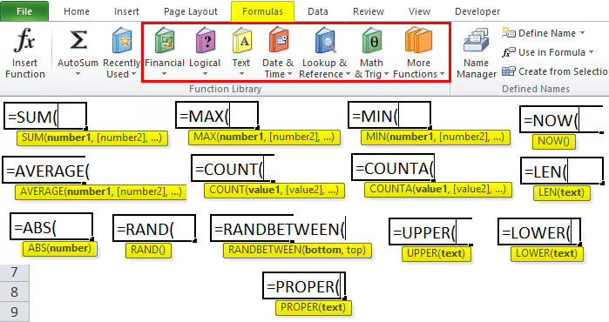
Basic Formulas
Basic formulas in Excel perform common calculations on a range of cells automatically.
These formulas include SUM, AVERAGE, COUNT, MIN, and MAX functions.
SUM adds all numbers in a specified range of cells.
AVERAGE calculates the mean of numbers in a range.
COUNT counts the number of numeric entries in a range.
MIN finds the smallest number in a range.
MAX finds the largest number in a range.
Source: https://www.projectcubicle.com/wp-content/uploads/2022/09/Basic-Formulas-in-Excel.png
Notes:
Basic formulas are one of the most powerful features of Excel because they allow you to perform calculations on multiple cells at once. Instead of adding numbers one by one or using a calculator, Excel can process entire ranges of data instantly. These formulas are particularly useful when working with large amounts of data, such as student records, expense lists, or inventory numbers.
The beauty of Excel formulas is that they work automatically. If any number in your data changes, the formula result updates immediately without having to recalculate manually.
Let us understand each basic formula with practical examples:
SUM Function – This adds all numbers in a range. The syntax is =SUM(range). For example, if student marks are in cells B2 to B10, typing =SUM(B2:B10) in cell B12 will give the total of all marks. This is useful for calculating total expenses, total attendance, or combined scores across subjects.
AVERAGE Function – This calculates the mean of numbers in a range. The syntax is =AVERAGE(range). Using =AVERAGE(B2:B10) will show the average marks of students. This helps teachers understand class performance or helps individuals track their monthly expenses on average.
COUNT Function – This counts how many cells contain numbers in a range. The syntax is =COUNT(range). Using =COUNT(B2:B10) will tell you how many students have marks recorded. This is helpful for attendance tracking or counting how many transactions occurred in a month.
MIN Function – This finds the smallest number in a range. The syntax is =MIN(range). Using =MIN(B2:B10) will show the lowest mark in the class. In real life, this can help identify the minimum expense in a budget or the lowest temperature recorded in a week.
MAX Function – This finds the largest number in a range. The syntax is =MAX(range). Using =MAX(B2:B10) will show the highest mark in the class. This can help find peak sales, highest temperature, or maximum expenditure in a given period.

Slide 9
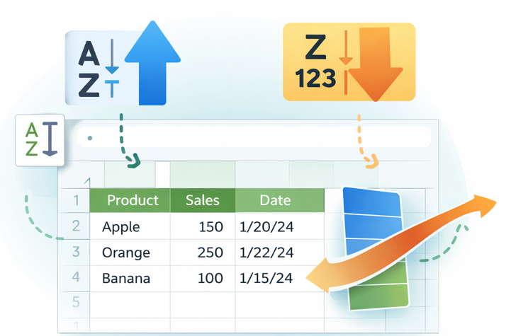
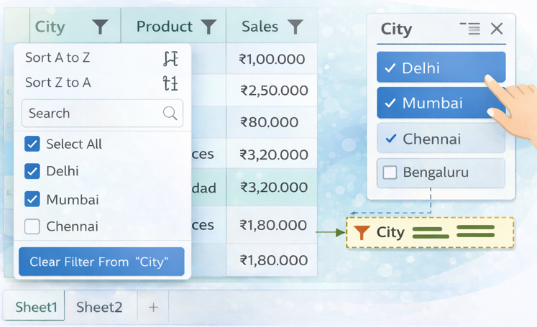
Sorting and Filtering Data in Excel
Sorting
Sorting helps arrange data in a specific order
Single-column vs. multi-column sorting
ascending/descending
custom sorts
Filtering
AutoFilter enables users to quickly view
Analyzing trends
Making data-driven decisions
Source: Multiple Images
Notes:
Sorting and filtering are two of the most powerful features in Excel for managing large amounts of data. While both tools help you work with data more efficiently, they work in completely different ways and serve different purposes. It is important to understand when to use each tool.
Sorting physically rearranges your data. When you sort a column, Excel moves the entire rows to put them in the order you specified. For example, if you sort student marks from highest to lowest, Excel will rearrange all the rows so that the student with the highest marks appears at the top, followed by the second highest, and so on. The original order of your data is changed permanently until you sort it differently. This is useful when you want to create ranked lists, arrange names alphabetically for reports, or organize dates chronologically. Once sorted, the data stays in that new arrangement.
Filtering, on the other hand, does not move or rearrange anything. Instead, it temporarily hides rows that do not match your criteria. For example, if you filter to show only students with marks above 80, Excel will hide all other rows but the data remains in its original position. When you remove the filter, all the hidden rows reappear exactly where they were before. This is useful when you want to focus on specific information without losing the original organization of your data.

Slide 10

Lab Activity
Lab 1.1: Performing Operations in Excel

Slide 11
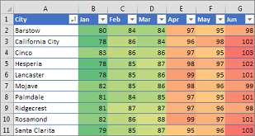
Conditional Formatting
Conditional formatting automatically changes the appearance of cells based on their values or user-set conditions.
It helps users quickly identify important data like high or low values, duplicates, or trends.
Cells can change color, font style, borders, or shading depending on specific rules.
Rules can be based on conditions such as values greater than a target or text containing certain letters.
Conditional formatting makes data easier and faster to analyze visually.
Source: Add the source here
Notes:
Conditional formatting is a useful feature in Excel that allows cells to change their appearance automatically when certain conditions are met. This feature helps highlight key data points without having to scan through rows and columns manually. For example, if you are managing student marks, conditional formatting can highlight all marks below a passing score in red, making it easy to identify students who need extra help.
The formatting changes can include cell background colors, font colors, bold or italic text, borders, or patterns. These visual cues make it easier to spot trends or problems quickly, even in large datasets.
You can set rules based on numbers or text. For instance, you might want cells to turn green if the value is above a target score, or highlight duplicate entries to catch errors. Text-based rules could highlight all cells containing a certain word or letter.
By using conditional formatting, users transform plain data into visually meaningful information, helping with faster data interpretation and making better decisions. For example, a sales report could use conditional formatting to show months where sales were above or below average, or an attendance sheet could highlight days with low attendance.

Slide 12

Charts in Excel
Chart Types and Uses​
Column and Bar charts compare categories, Line charts show trends, Pie charts illustrate parts of a whole.​
Chart Design Best Practices​
Use clear titles, sort bars logically, and avoid unnecessary 3D effects for clarity and effectiveness.​
Enhancing Readability​
Good chart hygiene improves readability and helps audiences quickly grasp key messages.
Source: https://upload.wikimedia.org/wikipedia/commons/thumb/7/73/Microsoft_Excel_2013-2019_logo.svg/1200px-Microsoft_Excel_2013-2019_logo.svg.png
Notes:
Charts are essential for communicating data insights visually. Different chart types serve different purposes: Column and Bar charts are ideal for comparing categories.
Line charts are used to show trends over time; and Pie or Donut charts are effective for illustrating part-to-whole relationships, especially when there are five or fewer slices.
To ensure clarity and effectiveness, charts should include clear titles, sort bars, and avoid unnecessary 3D effects.
Good chart hygiene enhances readability and helps the audience quickly grasp the key messages.
By selecting the appropriate chart type and maintaining visual clarity, users can make their data presentations more impactful and persuasive.​

Slide 13



Charts in Excel
Bar Chart
A bar chart displays data as rectangular bars with lengths proportional to the values they represent.
Line Chart
A Line charts help show trends or changes over time.
Pie Chart
A pie chart shows data as slices of a circle, with each slice representing a proportion of the whole.
Source: Icons
Notes:
Bar Chart
A bar chart is one of the simplest and most commonly used charts in Excel. It uses rectangular bars to represent data values. The key idea is that the length of each bar directly represents the quantity or value of the data point, allowing easy comparison between categories.
For example, a teacher might use a bar chart to compare the marks obtained by different students in an exam. Each student’s marks are represented as a bar, and it is simple to see who scored the highest or lowest by looking at the bar lengths.
Line Chart
A line chart is a useful way to show how data values change over time or across a sequence. It connects points with lines, emphasizing the flow from one data point to the next. This makes it easier to identify patterns such as increases, decreases, or consistent trends.
For example, a teacher might use a line chart to track a student’s marks over several exams. The connected points can show if the student’s performance is improving, staying the same, or declining.
Pie Chart
A pie chart divides a circle into slices where each slice size corresponds to the proportion of that part compared to the whole. This makes it easy to see how a total is distributed among different categories. For example, a teacher might use a pie chart to show the percentage of students who passed, failed, or were absent from an exam. Each slice would represent one of these categories, and the size of the slice reflects its share of the total student group.

Slide 14

Pivot Tables and Pivot Charts
Pivot tables in Excel summarize, analyze, and explore large datasets quickly.
Users can rearrange or "pivot" data dynamically to view different perspectives without changing the original data.
Pivot tables perform tasks like counting, summing, averaging, and sorting through simple drag-and-drop actions.
Pivot charts are visual representations of pivot table data and update automatically as the pivot table changes.
Pivot charts make it easier to see patterns, trends, and comparisons visually.
Source: https://uviclibraries.github.io/excel/images/excel-pivot-01.png
Notes:
Pivot tables are one of the most powerful features in Excel for working with large volumes of data. They allow users to organize and summarize data in ways that are meaningful without altering the original dataset. With just drag-and-drop actions, you can group and calculate data such as totals, averages, or counts.
For example, a sales report could use a pivot table to show total sales by product, region, or salesperson quickly. You can change rows and columns to see the data from different angles easily.
Pivot charts link directly to pivot tables and update automatically when the data is changed or filtered in the table. This means any adjustments in summaries instantly reflect in the visuals, helping users quickly identify important patterns or trends.

Slide 15
Lab Activity
Lab 1.2: Creating Pivot Tables and Charts

Slide 16

What is Microsoft Copilot?
Microsoft Copilot is an AI-powered assistant that works through your web browser.
Copilot uses large language models similar to ChatGPT to understand your requests.
You can access Copilot for free at https://copilot.microsoft.com/ with your Microsoft account.
Copilot helps you create, analyze, and plan content through natural conversation.
Source: https://encrypted-tbn0.gstatic.com/images?q=tbn:ANd9GcQkiQFjnO5QEB364vvWA2HL4-g4QTWdaa1jMA&s
Notes:
Microsoft Copilot is essentially your free AI assistant that you access through any web browser. Think of it as having a knowledgeable helper who can draft documents, help with Excel formulas, plan presentations, and answer questions – all through simple conversation.
It is powered by advanced AI models (currently GPT-4 technology as of 2026) and is designed specifically for productivity tasks.
While the premium "Microsoft 365 Copilot" that works directly inside desktop Office apps requires a paid subscription, the free Copilot Chat we will use today is surprisingly powerful.
You can access it from any computer, tablet, or even your phone by going to copilot.microsoft.com and signing in.

Slide 17

What You Can Access with Your Free Account
You can use Copilot Chat at https://copilot.microsoft.com/ as a free conversational AI tool.
You can access Word Online, Excel Online, and PowerPoint Online through OneDrive.
You receive 5GB of free cloud storage for your files on OneDrive.
You have the ability to share and collaborate on documents online with others.
Source: https://encrypted-tbn0.gstatic.com/images?q=tbn:ANd9GcRTzKV-WuvfOX-ySjduFyH1KppID7WZ2FQfTA&s
Notes:
Let me clarify what you have access to with just your free Microsoft account.
First, Copilot Chat – this is your main AI assistant that you will access through your browser.
Second, the Office Online apps – Word Online, Excel Online, and PowerPoint Online. These are web-based versions of the Office applications that work in your browser without installing anything. They are not quite as feature-rich as the desktop versions, but they have all the essential functionality you need for coursework and projects.
Third, you get 5GB of free OneDrive storage to save your files in the cloud, meaning you can access them from any device.
Finally, you can share documents and work together with classmates in real-time.
The key point: everything we are covering today requires zero payment – just your existing Microsoft account that you likely already have for email or other services.

Slide 18
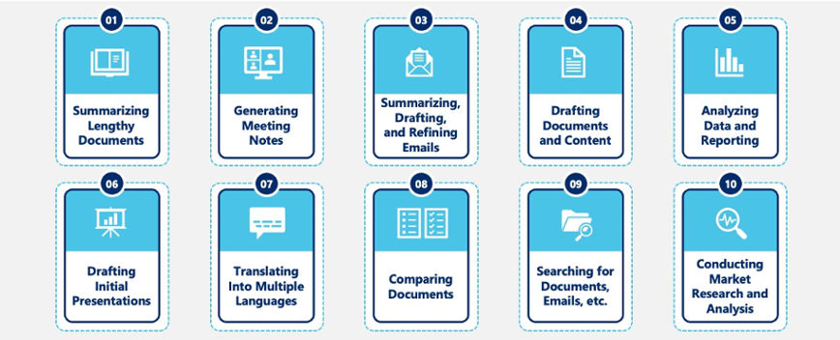
Why Use Copilot?
Source: https://cdn.neweratech.com/us/wp-content/uploads/sites/5/2024/07/10_use_cases_of_framework.jpg
Notes:
Let us explore the ten powerful ways you can use Copilot to enhance your productivity, as shown in this visual framework.
Summarizing documents – instead of reading through a 20-page report, you can ask Copilot to extract the key points in bullet format, saving you hours of reading time.
Generating meeting agendas – before any meeting, you can ask Copilot to create a structured agenda based on your meeting objectives.
Composing and drafting emails – Copilot can help you write professional emails quickly. Whether you need to request information, respond to inquiries, or send formal communications, Copilot can draft the email while you focus on the key message you want to convey.
Drafting documents and reports – when you have a blank page and need to write a report or proposal, Copilot can generate the first draft based on your outline and requirements.
Analyzing data and creating visualizations – for students working with Excel data, Copilot can suggest formulas, identify trends in your data, and recommend which type of chart best represents your findings. This is invaluable when creating dashboards or data presentations, building on the Excel skills you already have.
Drafting initial presentations – Copilot can create presentation outlines with suggested content for each slide.
Translating into multiple languages – If you need to communicate with international audiences or understand content in another language, Copilot can translate documents while maintaining the original context and meaning.
Comparing documents – When you have multiple versions of a document or need to identify differences between similar files, Copilot can compare them and highlight what has changed.
Searching for content – Instead of manually searching through folders and files, you can ask Copilot to find specific documents, emails, or information.
Conducting market research and analysis – When you need to gather information about industry trends, competitor analysis, or market conditions, copilot can synthesize information from multiple sources.

Slide 19
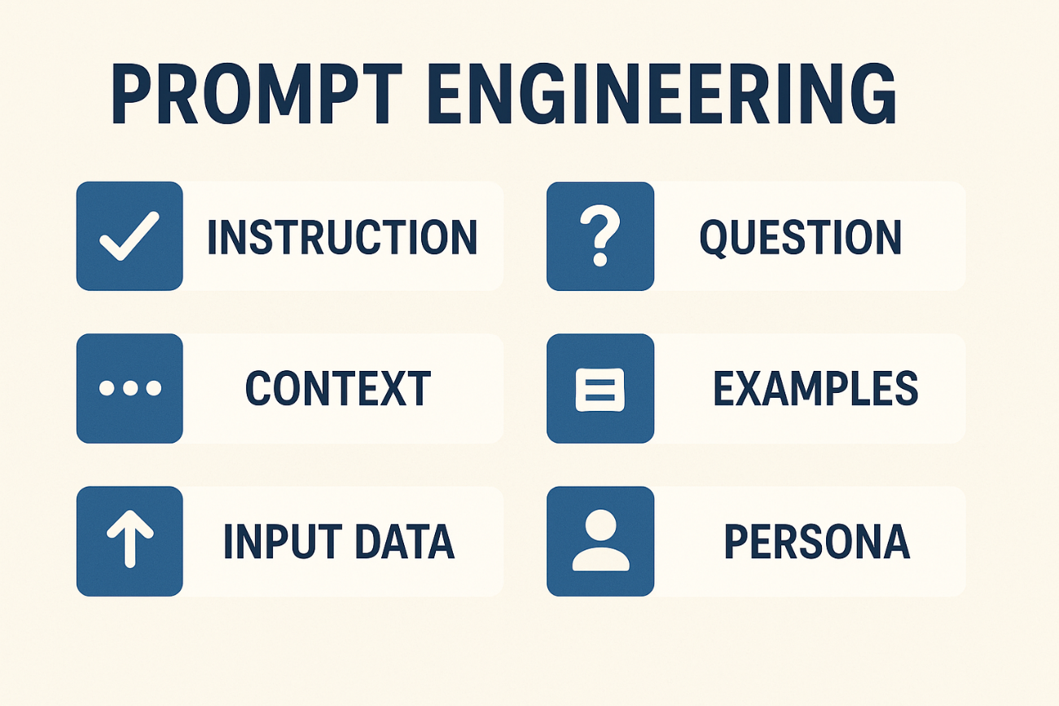
The Art of Prompt Engineering
A prompt is the instruction or question you give to Copilot to get a response.
Good prompts are clear, specific, and provide sufficient context for the AI.
Poor prompts are vague, too broad, or lack the necessary details for quality output.
Iteration is a normal part of the process where you refine your prompt based on initial results.
Source: https://miro.medium.com/1*JHh_d-exwA5NSaJZVCjQzg.png
Notes:
Prompt engineering is the skill of communicating effectively with AI, and it is the most important thing you will learn today.
Let us compare two prompts to see the difference.
Poor prompt: "Help with my essay." What is wrong with this? It does not tell Copilot what the essay is about, how long it should be, who the audience is, or what kind of help you need.
Good prompt: "Write a 300-word introduction for an essay about the impact of social media on mental health, aimed at undergraduate students in India.“
See how the second prompt specifies the topic, length, document section, audience, and context?
This gives Copilot everything it needs to produce relevant content.
Here is a practical framework for beginners – use the 4 C's: Be Clear (state exactly what you want), Concise (do not ramble with unnecessary information), Contextual (mention relevant details like audience and purpose), and Conversational (write naturally, like you are talking to a knowledgeable colleague). The good news is you will get better at this quickly with practice, and we will do plenty of that in today's activities.

Slide 20
Example Prompts – Good vs. Poor
Enter the content here
Poor: "Make something about technology."
Good: "Write a 250-word introduction explaining how smartphones have changed communication, suitable for a college presentation."
Poor: "Excel help."
Good: "Explain how to use the SUMIF formula in Excel to calculate total sales only for the Electronics category."
Poor: "Presentation ideas."
Good: "Create an outline for a 10-slide presentation about renewable energy sources for undergraduate engineering students."
Source:
Notes:
Let us look at three real examples comparing poor and good prompts.
In the first example, "Make something about technology" is terrible because "something" could mean anything – an essay, a list, a joke – and "technology" is an enormous topic. The good version specifies the document type (introduction), topic (smartphone communication impact), length (250 words), and audience (college presentation).
In the second example, "Excel help" tells Copilot nothing about what you are struggling with. The good version identifies the specific function (SUMIF), explains what you are trying to accomplish (calculate category-specific sales), and provides context (Electronics category).
In the third example, "Presentation ideas" is too vague – ideas about what? The good version specifies it is an outline, states the number of slides, identifies the topic clearly, and mentions the audience. Notice a pattern? Good prompts answer these questions: What type of content? About what specific topic? How long or how many? For whom? When you provide these details, Copilot can deliver exactly what you need instead of guessing. In our first activity, you will practice writing both types of prompts to see the difference firsthand.

Slide 21
Lab Activity
Lab 1.3: AI Automation in Excel

Slide 22
Lab Activity
Lab 1.4: Using Copilot in Excel

Slide 23

Summary
We learned in this Chapter:
How to use Microsoft Excel for organizing data, performing calculations with formulas, and creating charts.
How to enter different types of data and use basic formulas to perform calculations.
How to sort and filter data to organize large datasets.
How to use conditional formatting to highlight important data and create charts.
How to build pivot tables and pivot charts.
How to use Microsoft Copilot to help with Excel tasks, document writing, and data analysis.
How to combine Excel skills with Copilot to automate tasks, generate insights faster, and improve overall productivity in your work.
Notes:
We learned in this Chapter:
How to use Microsoft Excel for organizing data, performing calculations with formulas, and creating charts.
How to enter different types of data and use basic formulas to perform calculations.
How to sort and filter data to organize large datasets.
How to use conditional formatting to highlight important data and create charts.
How to build pivot tables and pivot charts.
How to use Microsoft Copilot to help with Excel tasks, document writing, and data analysis.
How to combine Excel skills with Copilot to automate tasks, generate insights faster, and improve overall productivity in your work.

Slide 24
Reference
https://support.microsoft.com/en-us/office/create-a-chart-from-start-to-finish-0baf399e-dd61-4e18-8a73-b3fd5d5680c2
https://support.microsoft.com/en-us/office/create-a-pivottable-to-analyze-worksheet-data-a9a84538-bfe9-40a9-a8e9-f99134456576
https://edu.gcfglobal.org/en/excel/charts/1/
https://www.tutorialspoint.com/excel_charts/excel_pivotcharts.htm
https://www.geeksforgeeks.org/excel/top-5-excel-data-cleaning-techniques-to-know-in-2023/
https://www.excel-easy.com/examples/pivot-chart.html
https://corporatefinanceinstitute.com/resources/excel/advanced-excel-formulas-must-know/
https://support.microsoft.com/en-us/office/text-functions-reference-cccd86ad-547d-4ea9-a065-7bb697c2a56e
https://support.microsoft.com/en-us/office/top-ten-ways-to-clean-your-data-2844b620-677c-47a7-ac3e-c2e157d1db19
https://www.thewallstreetschool.com/blog/understanding-text-functions-in-excel/
https://www.w3schools.com/excel/excel_formulas.php
https://www.geeksforgeeks.org/excel/pivot-tables-in-excel/

Slide 25
Reference
https://support.microsoft.com/en-us/office/get-started-with-copilot-in-excel-d7110502-0334-4b4f-a175-a73abdfc118a
https://www.computerworld.com/article/4119411/11-cool-things-copilot-can-do-in-excel.html
https://learn.microsoft.com/en-us/copilot/

Slide 26

QUIZ
Let’s Start

Slide 27


Quiz
1. Which Excel formula would you use to find the highest marks in a range of cells B2 to B10?
=SUM(B2:B10)
=AVERAGE(B2:B10)
=MAX(B2:B10)
=COUNT(B2:B10)
Answer: C
=MAX(B2:B10)
Notes:
The MAX function finds the largest number in a specified range. In this case, it will identify the highest marks among all students.

Slide 28
Quiz
2. What is the main difference between sorting and filtering data in Excel?
Sorting temporarily hides data while filtering permanently rearranges it
Sorting permanently rearranges data while filtering temporarily hides rows
Both sorting and filtering permanently delete unwanted data
Sorting and filtering perform the same function in Excel
Answer: B
Sorting permanently rearranges data while filtering temporarily hides rows
Notes:
Sorting permanently rearranges data while filtering temporarily hides rows

Slide 29
Quiz
3. Which of the following is a feature you can ask Copilot to create directly in Excel?
A new Microsoft account
A new column with calculated values using formulas
A new web browser window
A new PowerPoint presentation file
Answer: B
A new column with calculated values using formulas
Notes:
Copilot in Excel can analyze your data and suggest/create new columns with formulas automatically. For example, if you have sales data and profit margins, you can ask Copilot to "Add a column for total profit" and it will generate the formula =PriceQuantityMargin for you, saving time on manual formula writing.

Slide 30
Quiz
1. Which of the following is an example of a GOOD prompt for Microsoft Copilot?
"Help with Excel"
"Make something"
"Tell me about technology“
"Write a 300-word introduction about the impact of AI on education for college students"
Answer: D
Write a 300-word introduction about the impact of AI on education for college students
Notes:
Good prompts are clear, specific, and provide context about topic, length, and audience.

Slide 31
Quiz
5. What can you ask Copilot to do when working with Excel data analysis?
Create a new Microsoft Word document
Design a company logo
Suggest the best chart type and generate it automatically
Schedule a meeting in Outlook
Answer: C
Suggest the best chart type and generate it automatically
Notes:
Copilot in Excel analyzes your data and recommends the most appropriate chart type (bar, line, pie, etc.) based on your dataset. You can simply ask "Create the best chart for this data" and Copilot will suggest the visualization, generate it, and even add labels and formatting automatically—saving you time on manual chart selection and design.

Slide 32
Thank You

